Slide 1
An Interface for exploring the application of rewrite rules in Lift
Euan McGrevey

Slide 2
Context
Hardware has become increasingly parallel in recent years
Resulting in -> Performance Portability and Programmability.
Lift - Research Project (University of Glasgow, Edinburgh, and more)
High level functional language + Rewrite rules to tackle these problems

Slide 3
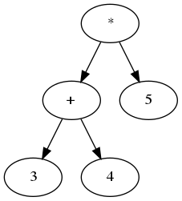
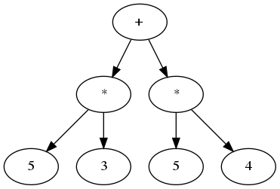
Motivation
Transforming expressions - what does that mean?
Rewrite rules as a way to encode optimisation choices
Why do we care about turning some expression into another?
Notes:
While Lift operates on full programs, rewrite rules themselves can operate on as small a construct as you want. For this project, we don’t use fulll program, but simple tree-based expressions that model simple Arithmetic.

Slide 4
Requirements
Given some starting expression and some goal expression, and a set of rewrite rules to use, can we get from the start to the goal?
Determine whether it is possible to turn a given expression into some other expression.
Bonus: Provide a means to replicate the transformation.
Notes:
Want: Yea it’s possible and here’s how you do it

Slide 5
Design
Expressions as Binary Trees - Extension to full program ASTs.
Scala? - Pattern Matching is key.
Rewrite rules and Rewrite results
Notes:
Idea being we can extend in the future. Handling a full AST syntax would be too much for an honours project.
3. Scala trait Success and Failure used for pattern matching over.

Slide 6
Implementation
Series of modular functions
Disregard efficiency for sake of ease of programmability
Worst case time complexity is exponential, so limiting factor.
Notes:
Start by solving a constrained version of the problem (i.e. don’t worry about replicating the transformation, or )
Tackle smaller side problems such as finding out all possible resultant trees from a single successful rule application on a single expression.

Slide 7
Case Study: Arithmetic Expressions
If the transformation is possible/impossible, the function will output so.
However, nonoptimal solutions in most cases
Notes:
But solution is guaranteed to be found in n steps if one exists.
I don’t have tests that demonstrate the function can find solutions with n depth in reasonable time. This could be done in further work.

Slide 8
Conclusion
Improvements
Future Work

